Slide 1

Wind Farms Designer
Team members
Asmaa Safwat Mohamed Sec(1)
Hossam Hassan Ali Sec(2)
Hossam Taha Abdelslaam Sec(2)
Hossam Hany Hemdaan Sec(2)
Sara Mahmoud Hassan Sec(2)
Mohamed Magdy Sec(3)
Supervisor Dr: Sherin Moussa
TA: Dina fawzy

Slide 2

Agenda
1) Introduction
2) Problem Definition
3) Objective
4) Related Works
5) System Architecture
6) SW Development Methodology
7) Functional Requirements.
8) System Analysis:
Usecase diagram.
System Sequence Diagram.
9) Software & Hardware Tools.
10) Time Plan

Slide 3
introduction
Nowadays, the technologies related to wind energy are receiving considerable attention because of the promotion of wind energy as an alternative resource for traditional energies .Some wind farms performed poorly or even failed because the conﬁgurations of the farms were not reasonable.
Hence, it is necessary to build up systematic approaches to the wind farm
Notes:
Field of wind farms in Egypt

Slide 4
Problem Definition
problems of :
optimally find the suitable place for wind farm .
optimally positioning of the turbines to make
the expected power production maximized.
Notes:
**Problem Definition :-
**Problem Definition :-
-an important problem of optimally find the suitable place for wind farm .
solving using dataSet of wind and weather and using it in some algorithm we nw can find easly the best place to make wind farm .
- An important phase of a wind farm design is solving the problem of optimally positioning
of the turbines within the wind farm so that the wake effects are minimized and
therefore the expected power production maximized.
currently, this problem is usually solved using very simple rules that lead to
rectilinear layouts where turbines are often organized in identical rows that are
separated by a conveniently large distance.
- And the problem of design the turbines so that the turbines resist the disturbances
and large wind speed.
- An important phase of a wind farm design is solving the problem of optimally positioning
of the turbines within the wind farm so that the wake effects are minimized and
therefore the expected power production maximized.
currently, this problem is usually solved using very simple rules that lead to
rectilinear layouts where turbines are often organized in identical rows that are
separated by a conveniently large distance.
- And the problem of design the turbines so that the turbines resist the disturbances
and large wind speed.

Slide 5
Objectives
check suitable location or not based on wind speed.
calculate number of turbines based on distance of farm.
establish distance between the turbines.

Slide 6
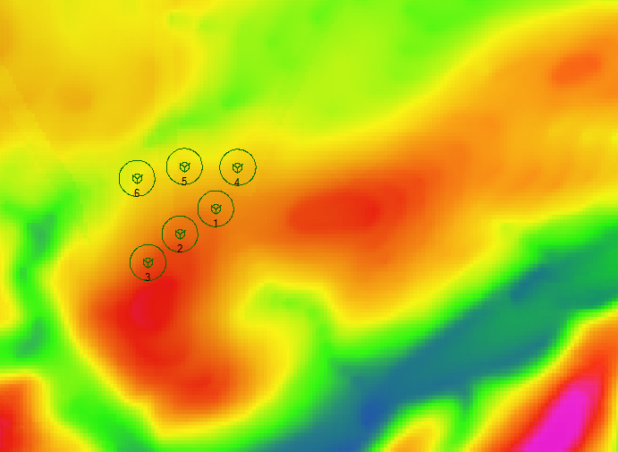
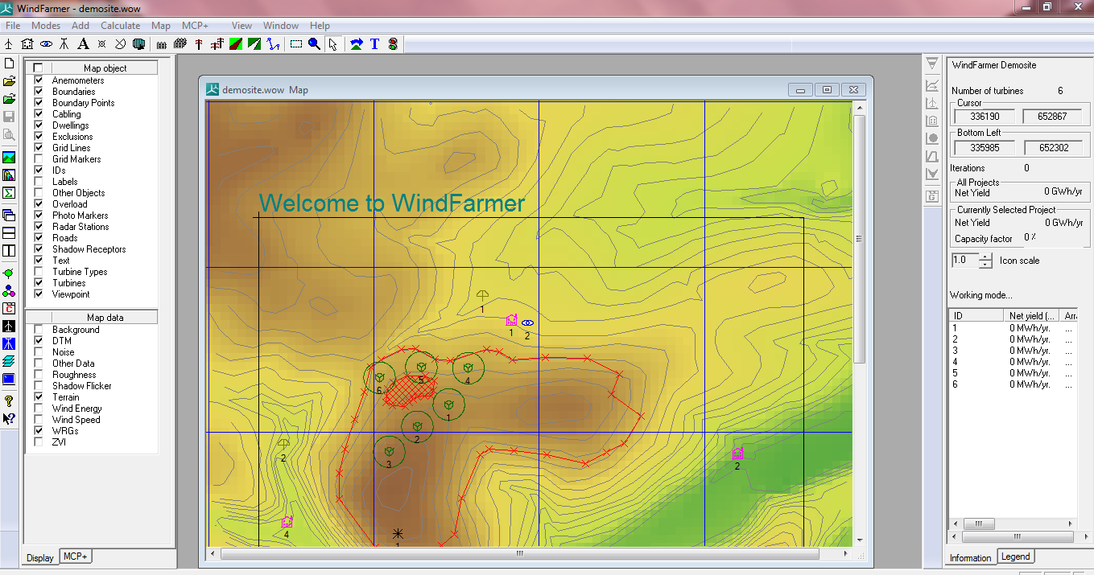
Related Works
Wind farmer system

Slide 7
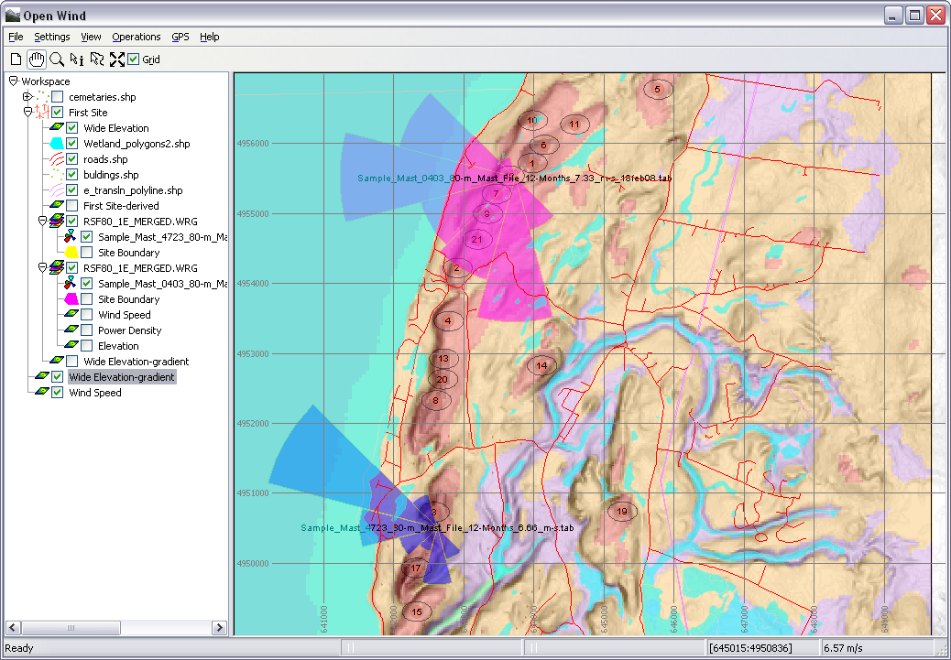
Related Works continue…
Open wind software (Open source )

Slide 8
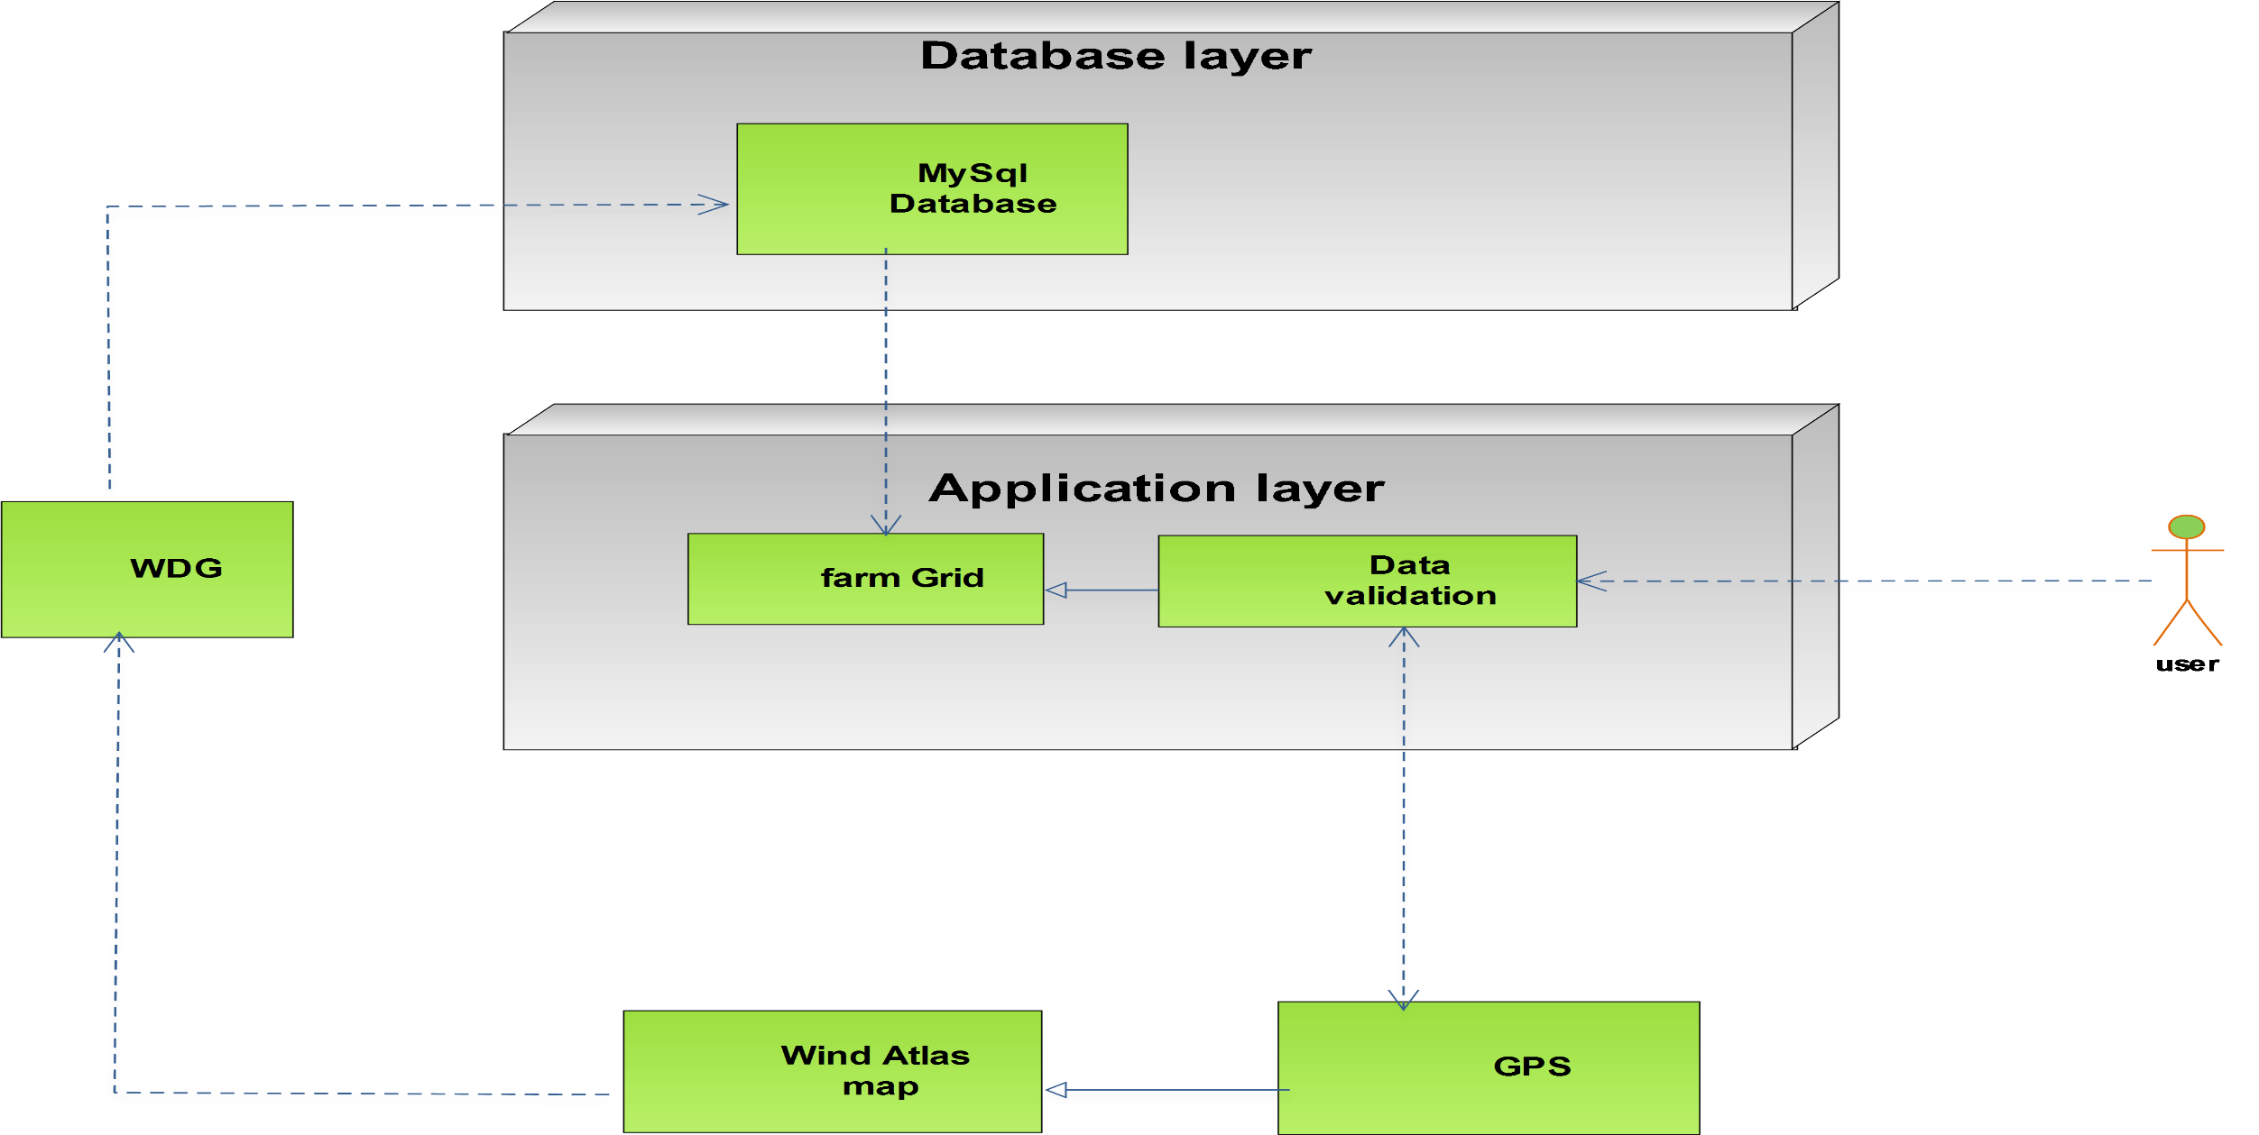
System architecture

Slide 9
SW Development Methodology

Slide 10
Functional requirements
Get coordinates
Define turbines properties
Validate coordinates
Get Wasp specific coordinates
Extract wind data from Wasp using WDG
Analysis wind data and Determine suitable farm place
Design wind farm layout

Slide 11
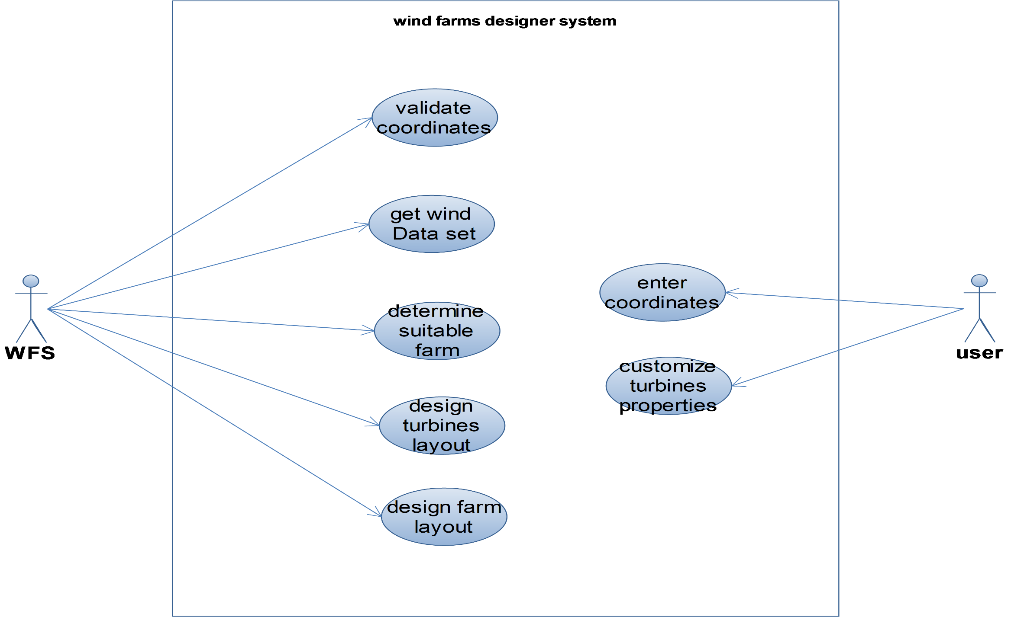
usecase

Slide 12
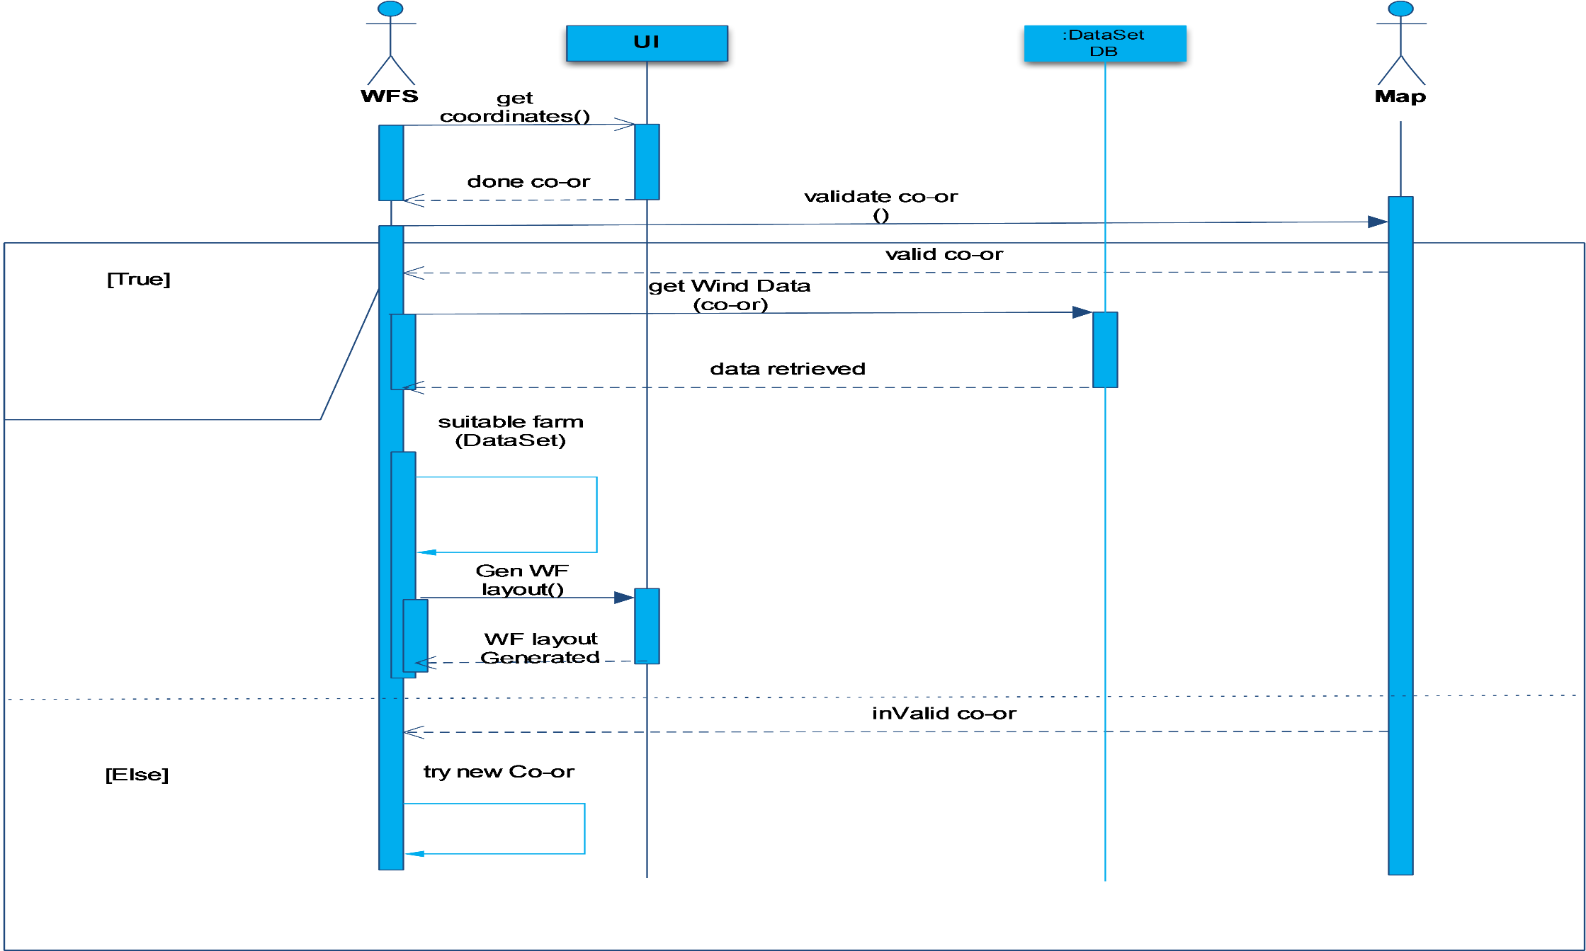
Sequence Diagram

Slide 13

Software Tools.
- Database (MySQL)
- Wind data generator
- Wind Atlas map
- GPS

Slide 14
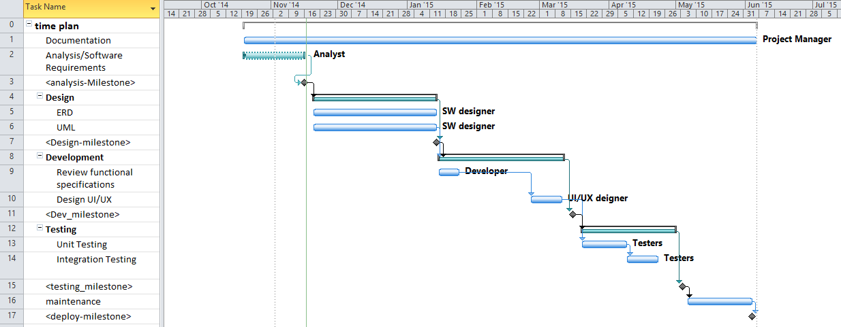
Time plan

Slide 15
References
Open wind software (www.awsopenwind.org)
Wind farmer software
(www.gl-garradhassan.com/en/software/GHWindFarmer.php )
Ant colony algorithm
genetic algorithm

Slide 16
Thank you .

